Slide 1
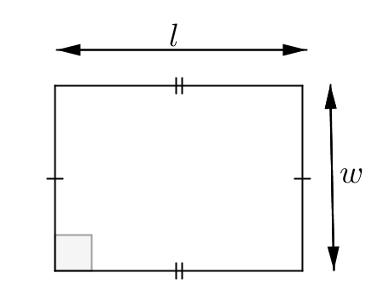
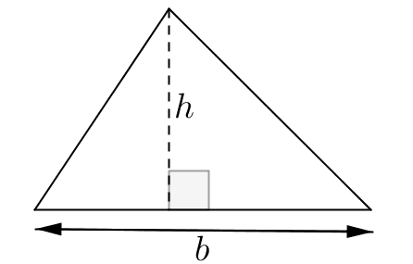
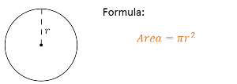
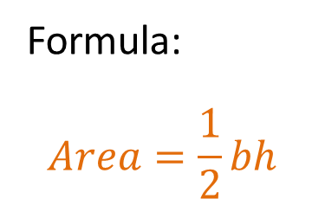
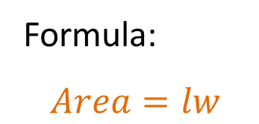
24
7
30
Area
Date
EQ – How we can use formulas to find areas of different shapes?
Formula:
$$Area=lw$$
Area of a rectangle
Formula:
$$Area=\frac{1}{2}bh$$
Area of a triangle
Area of circle

Slide 2


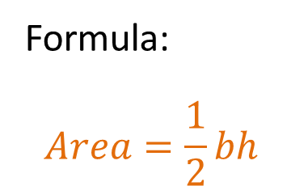
Formula:
$$Area=lw$$
Area of a rectangle
Formula:
$$Area=\frac{1}{2}bh$$
Area of a triangle
Area of circle
$$π≈3.14$$

Slide 3
Total Surface Area of a Rectangular Prism
7 cm
5 cm
15 cm
To find the TSA of a Rectangular Prism
Find the area of all 6 sides.
Add all 6 areas together

Slide 4
Find the area of all 6 sides.
7 cm
5 cm
15 cm
1. Choose 2 sides that are the same to start with.
2. Calculate their area.
A= Length x Width
= 7 x 5cm
= 35cm² each side
therefore combined they are 70cm²
Sides 1 and 2 area 70cm² combined

Slide 5
Find the area of all 6 sides.
Sides 1 and 2 area 70cm² combined
7 cm
5 cm
15 cm
1. Choose 2 more sides that are the same.
2. Calculate their area.
A= Length x Width
= 15 x 5cm
= 75cm² each side
therefore combined they are 150cm²
Sides 3 and 4 area 150cm² combined

Slide 6
Find the area of all 6 sides.
Sides 1 and 2 area 70cm² combined
Sides 3 and 4 area 150cm² combined
7 cm
5 cm
15 cm
1. Choose the last 2 sides that are the same.
2. Calculate their area.
A= Length x Width
= 15 x 7cm
= 105cm² each side
therefore combined they are 210cm²
Sides 5 and 6 area 210cm² combined

Slide 7
Find the area of all 6 sides.
Sides 1 and 2 area 70cm² combined
Sides 3 and 4 area 150cm² combined
Sides 5 and 6 area 210cm² combined
7 cm
5 cm
15 cm
Now add all the sides together.
Sides 1 and 2 area 70cm² combined
Sides 3 and 4 area 150cm² combined
Sides 5 and 6 area 210cm² combined
TSA = 70 + 150 + 210 = 430cm²

Slide 8
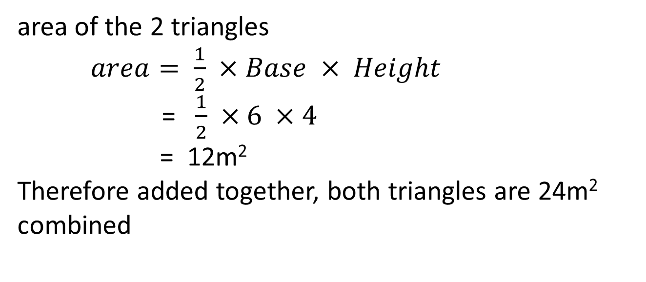
5m
To start, find the area of the 2 triangles
triangles are 24m² combined
7m
7m
6m
4m
area of the 2 triangles
$area= \frac{1}{2} ×Base × Height$
= $\frac{1}{2} ×6 ×4$
= 12m²
Therefore added together, both triangles are 24m² combined

Slide 9
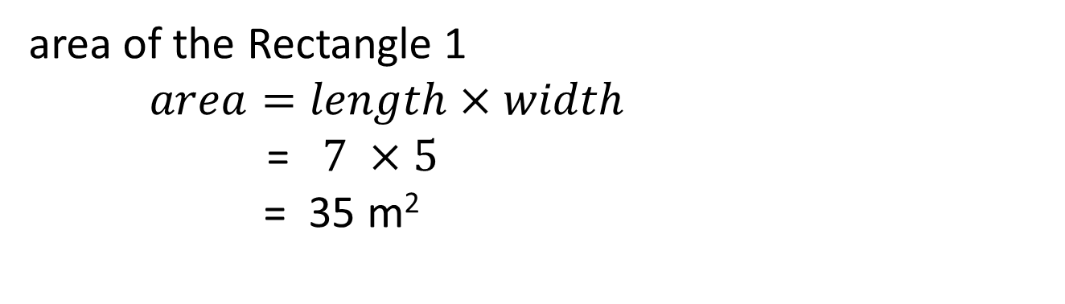
5m
To start, find the area of the 2 triangles
triangles are 24m² combined
Now find the area of the 3 rectangles
7m
7m
6m
4m
area of the Rectangle 1
$area=length×width$
= $7 ×5$
= 35 m²

Slide 10
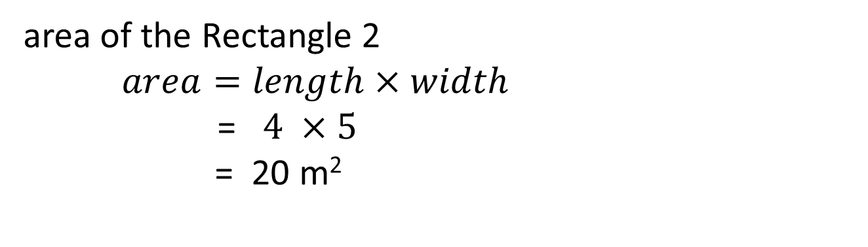
5m
To start, find the area of the 2 triangles
triangles are 24m² combined
Now find the area of the 3 rectangles
Rectangle 1 = 35m²
7m
7m
6m
4m
area of the Rectangle 2
$area=length×width$
= $4 ×5$
= 20 m²

Slide 11
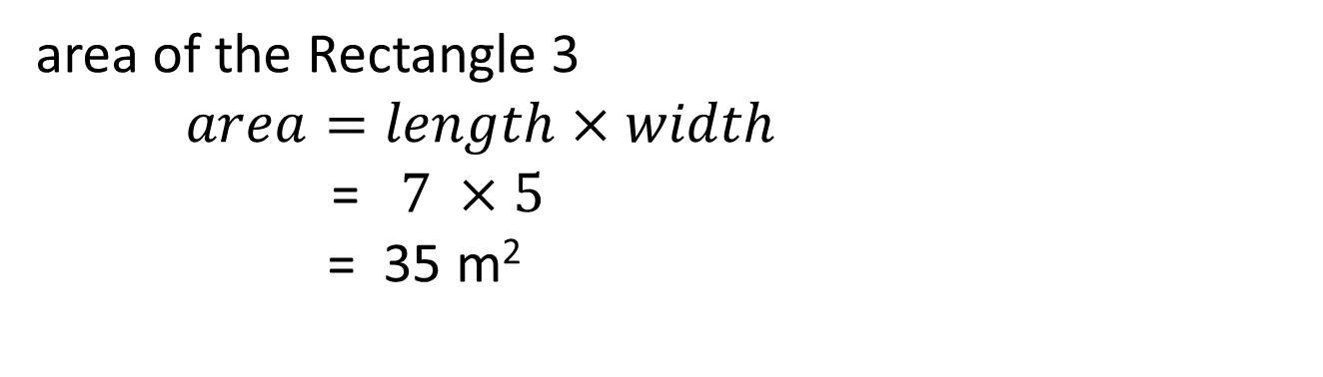
5m
To start, find the area of the 2 triangles
triangles are 24m² combined
Now find the area of the 3 rectangles
Rectangle 1 = 35m²
Rectangle 2 = 20m²
7m
7m
6m
4m
area of the Rectangle 3
$area=length×width$
= $7 ×5$
= 35 m²

Slide 12
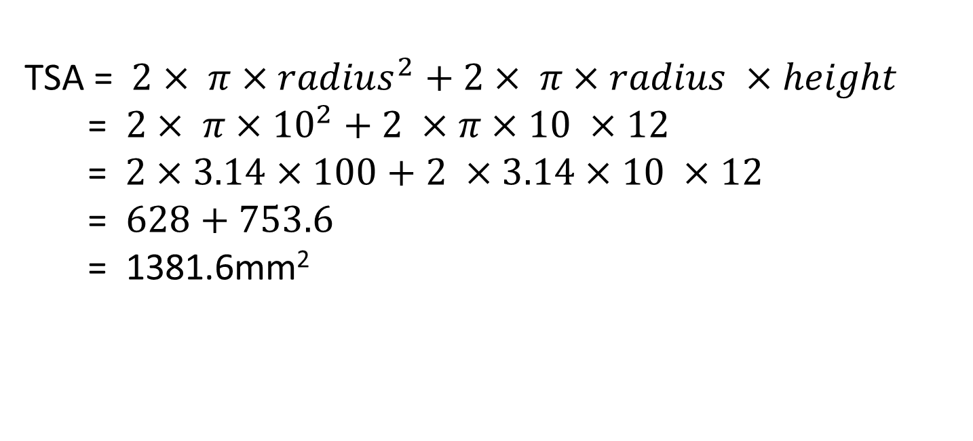
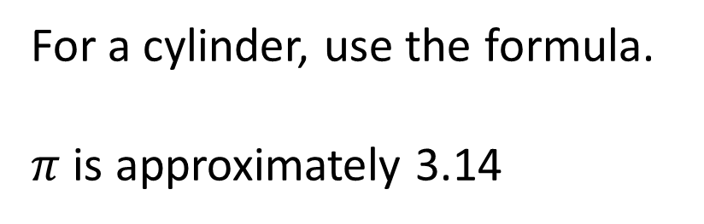
For a cylinder, use the formula.
$π$ is approximately 3.14
10mm
12mm
TSA = $2× π×{radius}^{2}+2× π×radius ×height$
= $2× π×{10}^{2}+2 ×π×10 ×12$
= $2×3.14×100+2 ×3.14×10 ×12$
= $628+753.6$
= 1381.6mm²

Slide 13
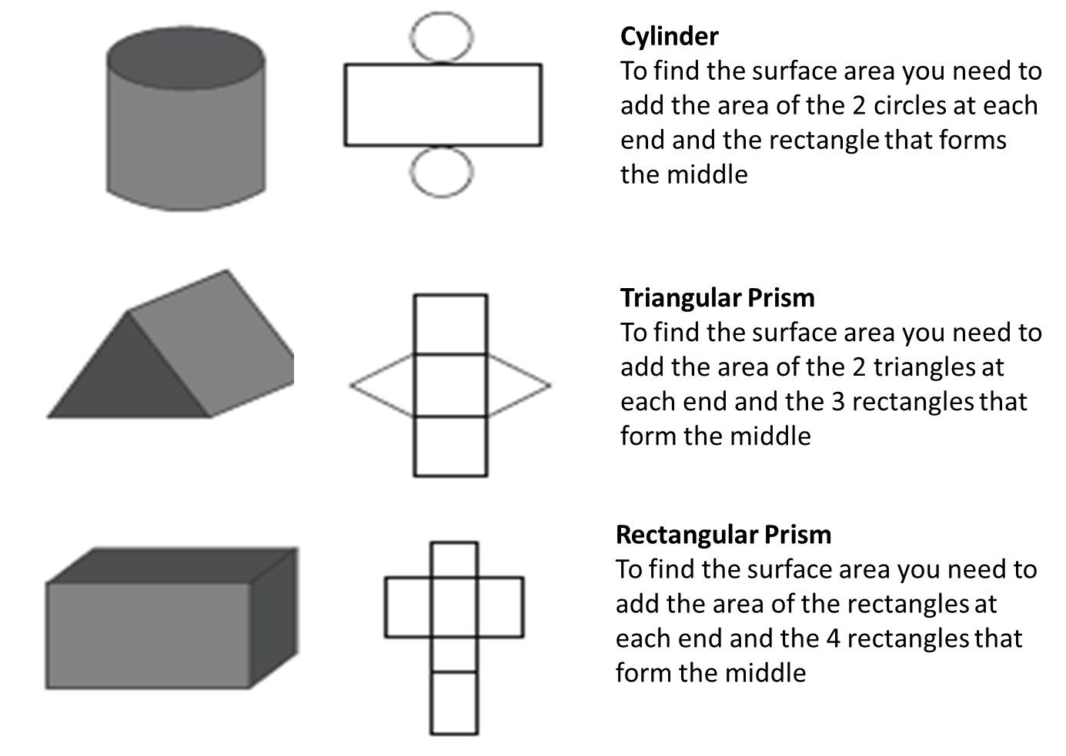
To find the surface area of composite shapes you need to break the shapes down into shapes you can work with.
=
+

